Slide 1


Smart Scrum Doc: Automated Scrum Meeting Documentation System
BY
2211CS050023 - Devansh Mishra
2211CS050029 - Geetha Sirvi
2211CS050062 - Mandham Sahithi
Under the guidance of
Dr.M.V.N Srujan Manohar
Associate professor
Department of Internet of Things(IOT)
School of Engineering
Malla Reddy University
Hyderabad, Telangana, INDIA

Slide 2
Contents :
i Abstract
Introduction
System Analysis
Architectural Design
Implementation

Slide 3
i. Abstract:
Scrum meetings are very important in software development, but many teams do not maintain proper written records of what was discussed, decided, and assigned. Because of this, team members sometimes forget their responsibilities or deny previous commitments, which creates confusion and affects productivity. In this project, we have developed a web-based application that helps generate clear Scrum meeting documentation from recorded audio. The system converts the meeting audio to text, allows users to easily mark key sentences as action items or decisions, and stores them along with speaker names and timestamps. It also provides a simple interface to search within the transcript and download the final minutes as a PDF. This tool aims to improve transparency, accountability, and follow-up in Scrum-based teams while keeping the workflow easy to use for students and professionals.
This project proposes an AI-assisted web application that automatically generates structured Scrum meeting minutes from recorded audio. The system converts meeting audio into text, allows users to tag key sentences as action items and decisions, and stores these along with speaker names and timestamps.

Slide 4
1.Introduction:
1.1 Problem Definition & Description:
In Scrum-based software development, meetings such as sprint planning, reviews, and discussions play a crucial role in gathering client requirements and making project decisions. However, these meetings are primarily conducted verbally and often lack proper documentation, leading to missed requirements, misunderstandings, and poor accountability among team members. Manual note-taking is time-consuming, inconsistent, and ineffective when multiple participants are involved. Existing meeting tools focus mainly on communication and do not provide intelligent analysis or structured documentation of Scrum discussions. As a result, Scrum Masters and development teams struggle to track what was discussed, what decisions were made, and how actively participants contributed. There is a clear need for an automated system that can capture Scrum meeting discussions, convert speech into structured text with speaker identification and timestamps, extract product backlog items from client inputs, generate concise meeting summaries, and analyze individual participation to improve transparency, efficiency, and accountability in Scrum teams.
1.2 Objective of the Project:
The objective of this project is to develop a web-based system that automates the documentation and analysis of Scrum meetings by converting spoken discussions into structured text with speaker identification and timestamps. The system aims to generate concise meeting summaries, extract client-defined product backlog items, analyze discussion topics, and measure individual participation through speaking percentage. By providing organized Scrum meeting minutes and analytics, the project seeks to improve transparency, accountability, and efficiency in Scrum-based software development teams.

Slide 5

1.3 Scope of the Project:
The scope of this project is limited to the development of a web-based application that supports Scrum meeting documentation for a small group of participants, specifically a client, developer, and Scrum Master. The system focuses on real-time speech-to-text conversion, storage of meeting transcripts with speaker identification and timestamps, extraction of product backlog items, generation of meeting summaries, and analysis of individual speaking participation. The project covers basic authentication, meeting management, transcript analysis, and report generation, while excluding advanced features such as real-time speaker diarization accuracy optimization, large-scale user management, video conferencing, and complex machine learning model training. The system is intended as a functional prototype suitable for academic and small-team use.

Slide 6
2. System Analysis
The proposed system is designed to analyze and automate the documentation of Scrum meetings by integrating web technologies and basic natural language processing techniques. The system allows authenticated users—Client, Developer, and Scrum Master—to participate in a common meeting environment where audio input is captured through the browser. The captured audio is converted into text using speech-to-text technology, and each spoken segment is tagged with the speaker’s identity and timestamp. The system processes this transcript data to perform multiple analyses, including summarization of meeting discussions, extraction of product backlog items based on client inputs, identification of discussion topics, and calculation of individual speaking percentages. Data persistence is handled through a backend server and database, ensuring structured storage and retrieval of meeting information. The system emphasizes accuracy, usability, and transparency while maintaining a simple and scalable architecture suitable for academic implementation and demonstration purposes.

Slide 7
2.1 Existing System:
2.1.1 Background & Literature Survey:
Recent research and industry studies show a growing need for automated meeting intelligence systems due to the inefficiency of manual meeting documentation and backlog identification. Studies on automatic meeting minutes generation demonstrate that speech-to-text and NLP techniques can reliably convert discussions into structured summaries and action items. Research on product backlogs in Scrum confirms that identifying requirements directly from stakeholder conversations improves backlog clarity and reduces requirement gaps. Industry implementations, such as AI-powered Microsoft Teams summarizers using transformer models and Named Entity Recognition (NER), validate the feasibility of extracting decisions, tasks, and keywords from live meetings. Academic works published in journals like IJRASET and institutional repositories further support the use of ASR, speaker diarization, and text summarization models for meeting analysis. Overall, the reviewed literature confirms that combining speech processing with NLP enables accurate meeting transcription, backlog extraction, speaker analysis, and summary generation, making the proposed system technically sound and suitable as a major academic project.
2.1.2 Limitations of Existing System:
Existing meeting systems mainly focus on communication and rely on manual note-taking for documentation, which is time-consuming and error-prone. They do not provide automated speech-to-text conversion with speaker identification, making it difficult to track discussions accurately. Additionally, these systems lack features for automatic meeting summaries, product backlog extraction, and participant analysis, resulting in poor traceability, accountability, and follow-up after Scrum meetings.

Slide 8
2.2 Proposed System:
The proposed system is a web-based application that automates the documentation and analysis of Scrum meetings by converting spoken discussions into structured text with speaker identification and timestamps. It enables multiple participants to join a common meeting room and captures real-time speech using browser-based speech-to-text technology. The system analyzes the generated transcripts to produce concise meeting summaries, extract client-defined product backlog items, identify discussion topics, and calculate individual speaking percentages. All meeting information is securely stored and compiled into structured Scrum meeting minutes, which can be viewed or downloaded for future reference. The proposed system improves transparency, accountability, and efficiency in Scrum-based software development teams by eliminating manual documentation.

Slide 9
Literature Survey Links:
1) https://medium.com/%40donchominkov/transforming-meetings-and-docs-with-ai-speech-to-text-6ede267abd5b
2) https://www.sciencedirect.com/science/article/pii/S0950584924002490
3) https://medium.com/%40riyaelizabet/building-an-ai-powered-microsoft-teams-meeting-summarizer-transformers-ner-azure-b6e6f4fbb819
4)https://www.ijraset.com/research-paper/automatic-meeting-minutes-generation
5) https://www.itm-conferences.org/articles/itmconf/pdf/2022/04/itmconf_icacc2022_03063.pdf
6) https://www.researchgate.net/publication/360456552_Automatic_Generation_of_Minutes_of_Meetings
7) https://papers.ssrn.com/sol3/papers.cfm?abstract_id=5319091
8) https://dl.acm.org/doi/10.1145/3633598.3633600
9) https://www.researchgate.net/publication/220655948_Speaker_Diarization_A_Review_of_Recent_Research
10) https://rjpn.org/ijcspub/papers/IJCSP23B1312.pdf

Slide 10
2.3 Software & Hardware Requirements:
2.3.1 Software Requirements:
Windows
Mobile application
Internet Access
2.3.2 Hardware Requirements:
Supports PC / Laptop / Mobile
Minimum 2 GB of RAM for smooth experience
Network Connectivity
Web tech configurations
2.4 Feasibility Study:
2.4.1 Technical Feasibility:
The proposed system is technically feasible as it is built using reliable and widely adopted hardware, software, and development tools. The technologies required for implementation are easily available, cost-effective, and compatible with existing systems. The development can be carried out using standard programming languages and platforms, ensuring ease of integration, testing, and maintenance. Additionally, the system does not require highly specialized technical expertise, reducing implementation risks and making future upgrades and scalability manageable.

Slide 11
2.4.2 Robustness & Reliability:
The proposed system is designed to operate reliably under varying conditions and workloads. It incorporates error-handling mechanisms, validation checks, and fallback processes to ensure consistent performance even in the presence of incomplete or noisy data. The use of proven algorithms and stable platforms enhances system robustness, while modular design allows individual components to function independently without affecting the overall system. Regular monitoring, logging, and testing further improve reliability, ensuring accurate outputs, minimal downtime, and dependable operation over extended periods.
2.4.3 Economic Feasibility:
The project is economically feasible as it leverages cost-effective technologies and open-source tools, reducing development and licensing expenses. Most of the required infrastructure can be implemented using existing hardware and cloud-based services with flexible, pay-as-you-go pricing models. Automation of tasks significantly lowers operational and manual labor costs, while improved efficiency and accuracy provide long-term cost savings. Overall, the benefits gained from reduced time, effort, and resource utilization outweigh the initial investment, making the project financially viable.

Slide 12
3.Architectural Design
3.1 Modules Design
The Smart Scrum Doc is structured into multiple modules, each catering to specific roles and functionalities. These modules ensure smooth workflow automation, secure data handling, and efficient user interaction.
User Interface Module
To provide an easy and interactive way for users to record or upload meetings and access transcripts and summaries.
The interface allows users to start/stop recording or upload audio files. It sends the audio input to the backend modules and displays the generated transcript, summary, and action items.
Audio Capture & Preprocessing Module
Raw audio often contains noise, silence, and volume variations that reduce recognition accuracy.
The module captures audio and applies noise reduction, normalization, and segmentation to enhance speech clarity before further processing.
Voice Activity Detection (VAD) Module
To remove silence and background sounds, reducing unnecessary processing and improving efficiency.
It detects time segments containing human speech and filters out non-speech portions, forwarding only relevant audio to the speech recognition module.

Slide 13
Speech-to-Text (ASR) Module
To convert spoken meeting audio into readable text automatically.
Using trained ASR models, the module processes speech segments and generates accurate textual transcripts in real time or batch mode.
Speaker Diarization Module
Meetings involve multiple participants, making it necessary to identify who spoke at each moment.
The module analyzes voice characteristics to segment audio by speaker and assigns speaker labels to the transcript.
Natural Language Processing (NLP) Module
To understand the meaning of the transcribed text and extract useful information.
NLP techniques identify key topics, named entities, decisions, and action items from the transcript.
Meeting Summarization Module
Long transcripts are time-consuming to review.
The module applies extractive or abstractive summarization techniques to generate concise meeting summaries highlighting important discussions and outcomes.
Structured Transcript Generator Module
Unstructured text is difficult to read and analyze.
It organizes the transcript into a structured format with speaker names, timestamps, summaries, and action items.
Each module ensures efficient collaboration, transparency, and automation, making the system scalable, secure, and user-friendly.

Slide 14
3.2 Methods and Algorithms:
Methods & Algorithm of Smart Scrum Doc
The Smart Scrum Doc is developed using Django for the user interface and SQLite for database management, ensuring a lightweight, efficient, and cost-effective solution. The following methods and algorithms facilitate smooth workflow automation and data handling.
1. Meeting Creation & Audio Capture Module
Method:
Enables authenticated users to create and join meeting sessions.
Captures real-time audio streams from multiple participants.
Algorithm:
User clicks “Create/Join Meeting”.
System initializes audio recording session.
Audio input is continuously captured during the meeting.
Audio data is forwarded to preprocessing module.
2. Audio Preprocessing & Voice Activity Detection (VAD)
Method:
Improves audio quality by removing noise and silence.
Uses Voice Activity Detection to identify speech segments.
Algorithm:
Audio signal is normalized and filtered.
Silence and background noise are detected.

Slide 15
Non-speech segments are discarded.
Clean speech segments are passed to next module.
3. Speech-to-Text Conversion (ASR)
Method:
Converts spoken audio into textual format.
Generates timestamps for each spoken segment.
Algorithm:
Receives speaker-wise audio segments.
Applies Automatic Speech Recognition model.
Converts speech to text.
Attaches timestamp and speaker label.
4. Structured Transcript Generation
Method:
Organizes raw transcriptions into a readable structure.
Improves clarity for analysis and reporting.
Algorithm:
Collects ASR Output.
Format data as :
Speaker id – timestamp - text
Stores structured transcript in database

Slide 16
5. NLP-Based Product Backlog Extraction
Method:
Identifies product backlog items mentioned by the client.
Uses Natural Language Processing techniques.
Algorithm:
Tokenizes meeting transcript.
Applies keyword matching and NER.
Detects backlog-related statements.
Stores extracted backlog items separately.
6. Meeting Summarization Module
Method:
Reduces long transcripts into concise summaries.
Highlights important discussion points.
Algorithm:
Analyzes full transcript.
Identifies key sentences.
Generates summary using summarization algorithm.
Stores final meeting summary.

Slide 17
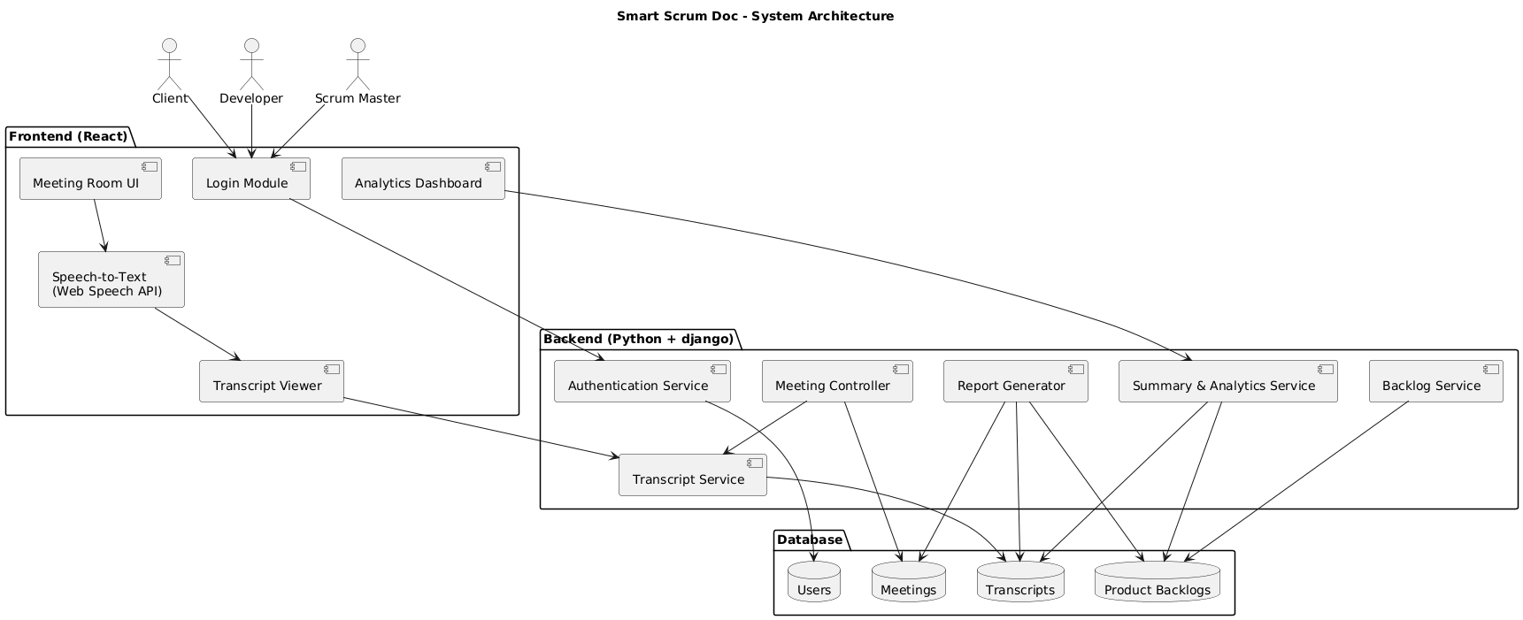
3.3 Project Architecture:
3.3.1 Architecture Diagram:

Slide 18
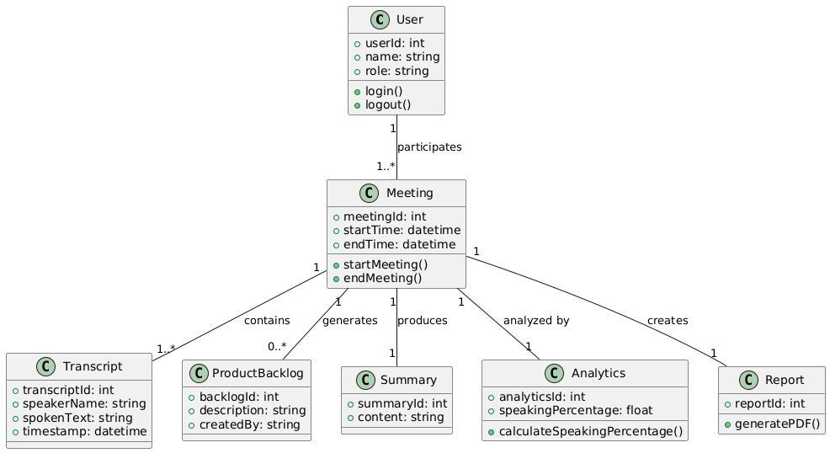
3.2.2 Class Diagram:

Slide 19
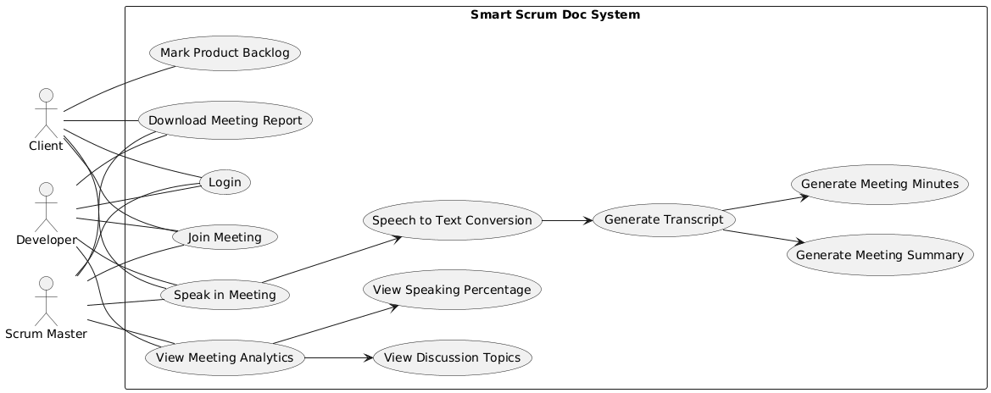
3.2.3 Use Case Diagram:

Slide 20
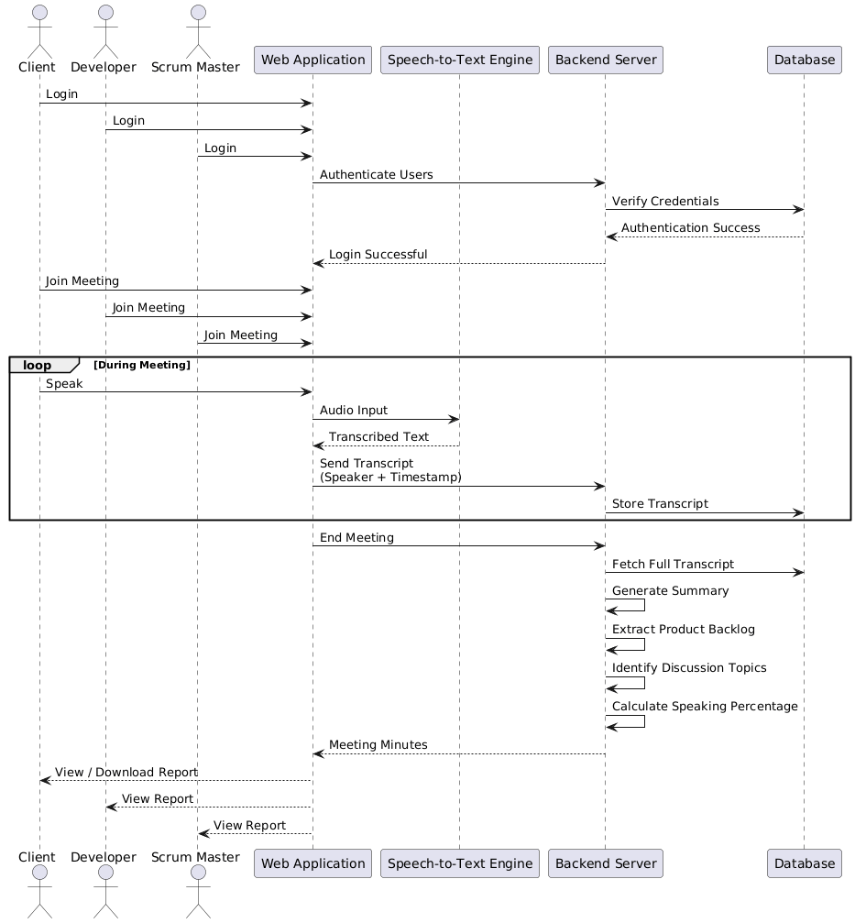
3.2.4 Sequence Diagram:

Slide 21
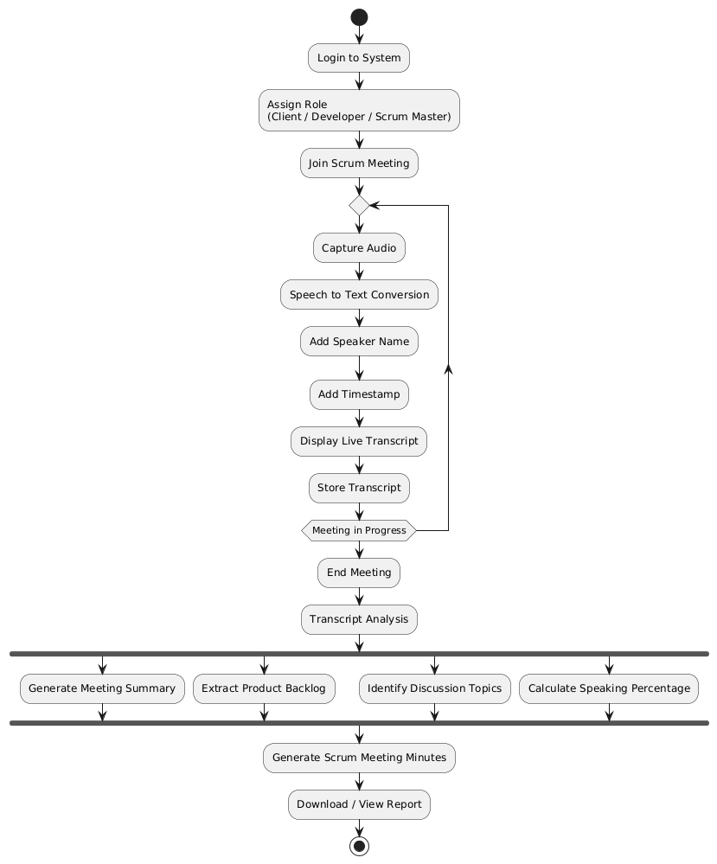
3.2.5 Activity Diagram:

Slide 22
4. Implementation & Testing
Present in the Laptop

Slide 23
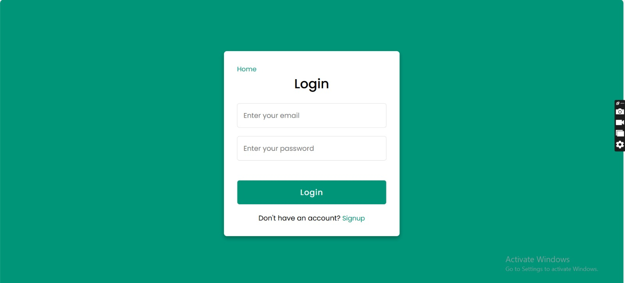
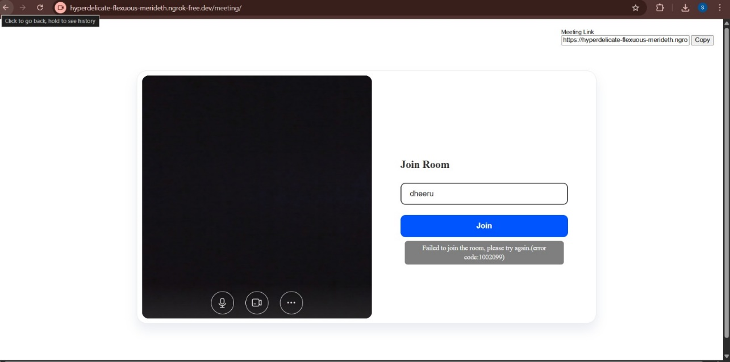
Result:
Current Results Upto 2/6/26 :

Slide 24
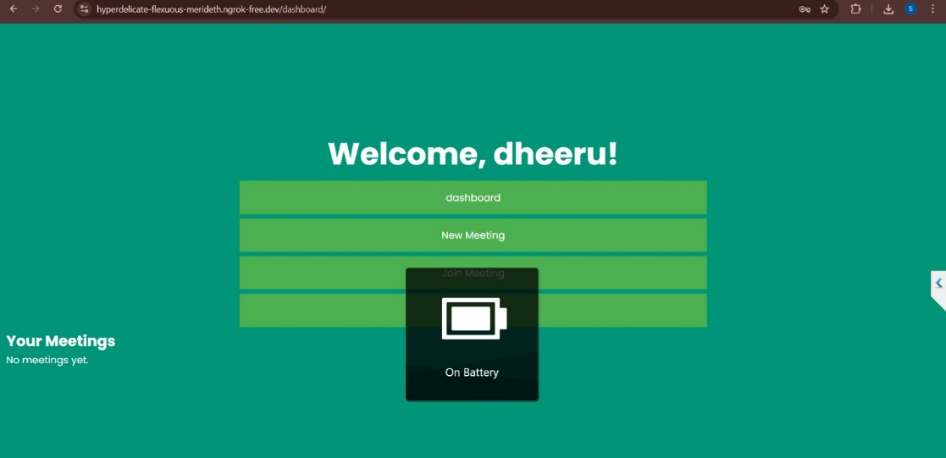
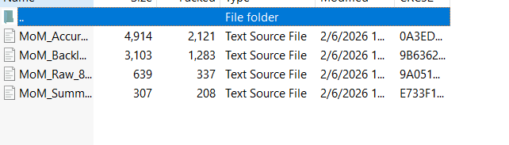
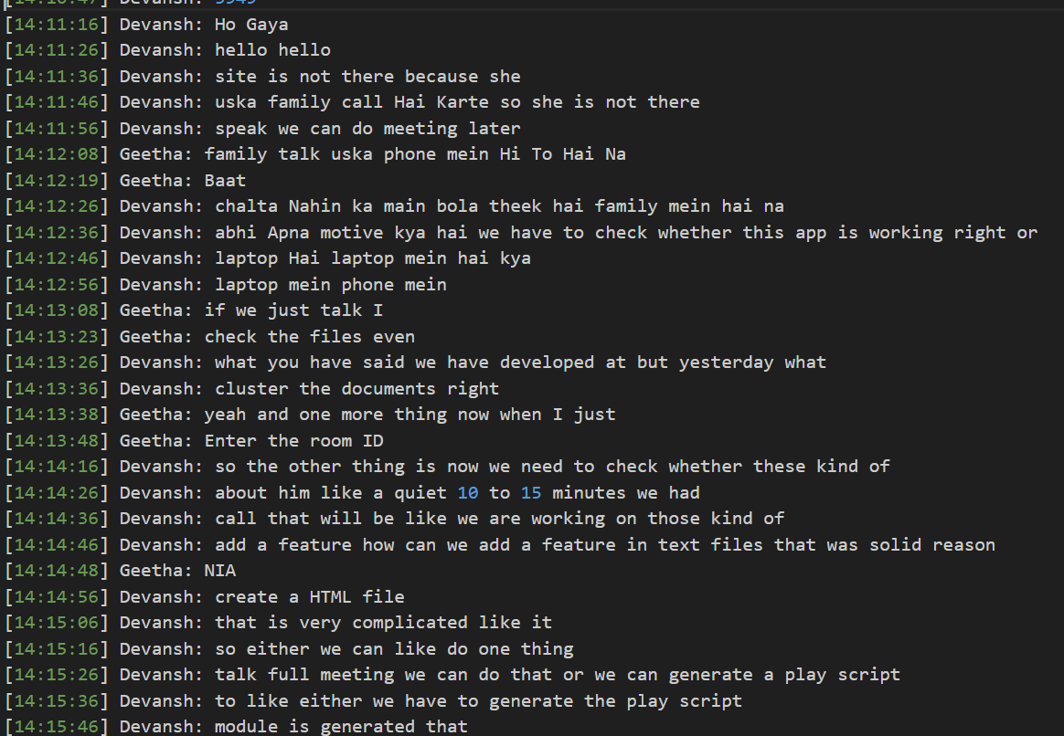
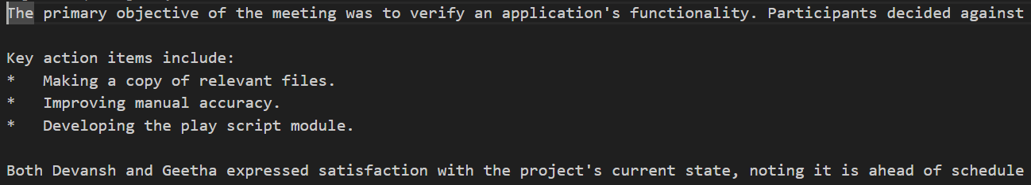
4. Implementation & Testing
Present in the Laptop

Slide 25

Thank You

